Slide 1


Haqeeq Ruman
22i-0917
Haniya Sajjad
22i-1081
Kashf Khan
22i-0793
UPDATING SINGLE-SOURCE SHORTEST PATHS IN
LARGE-SCALE DYNAMIC NETWORKS
A novel parallel algorithmic framework for updating the SSSP in large-scale dynamic networks.

Slide 2
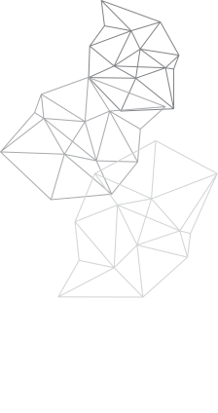
CONTENT OF THE PRESENTATION
OVERVIEW OF THE PAPER
ALGORITHM ANALYSIS
PROPOSED SOLUTION
RESULTS
1
2
3
4

Slide 3




OVERVIEW OF THE PAPER
THE PROBLEM
Many networks arising from real-world applications are extremely large (order of millions of vertices and order of billions of edges). They are also often dynamic, in that their structures change with time.
Thus, fast analysis of network properties requires:
(i) efficient algorithms to quickly update these properties as the structure changes, and
(ii) parallel implementations of these dynamic algorithms for scalability.

Slide 4



ALGORITHM ANALYSIS
01
Static Graphs
02
Algorithm 01
03
Algorithm 02
Numerous algorithms can compute the SSSP in static networks and sequentially update the SSSP.
Identify the subgraph (a set of vertices) affected by
changes.
Update this subgraph to create a new SSSP tree.

Slide 5
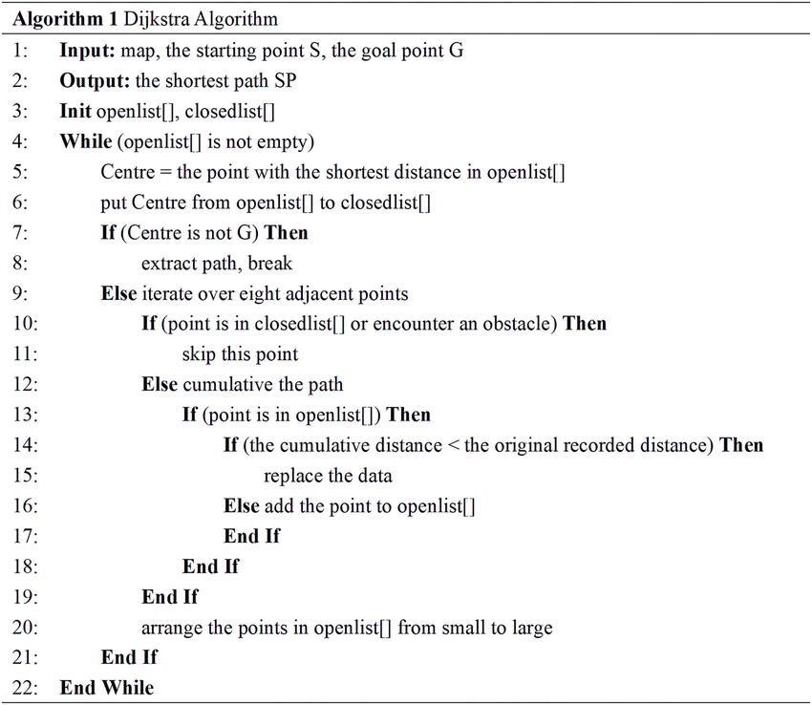
STATIC GRAPHS
DIJKSTRA ALGORITHM

Slide 6
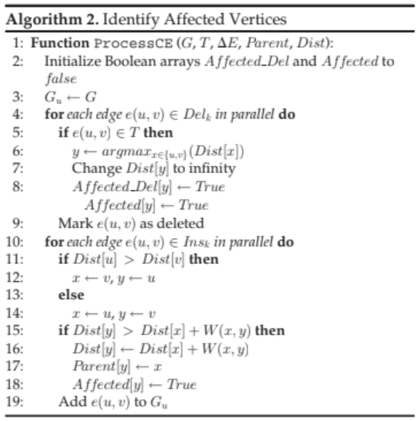
ALGORITHM 01
DETECTION ALGORITHM

Slide 7
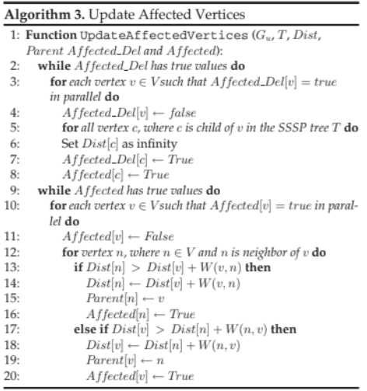
ALGORITHM 02
UPDATION ALGORITHM

Slide 8
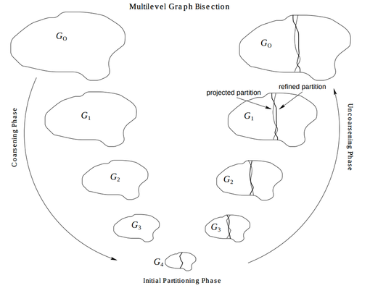
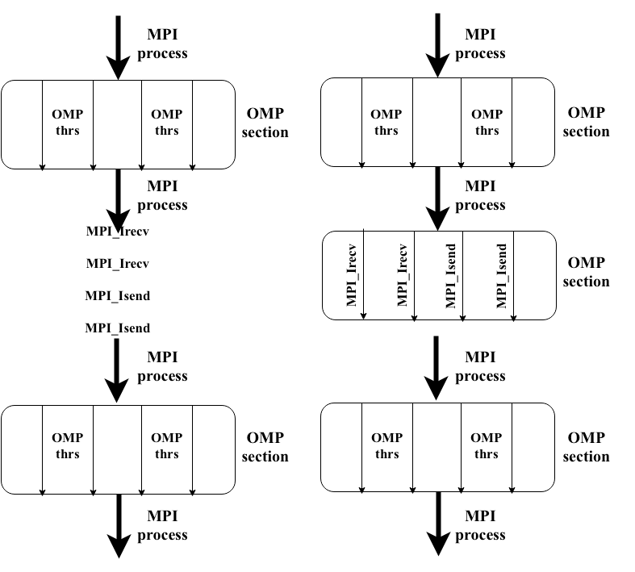
Think of METIS like a city planner who divides a city (graph) into equal zones (partitions).
But YOU are the construction team — each team (MPI process) gets a zone and uses OpenMP to build roads (paths), repair traffic (edge updates), and optimize traffic flow (MOSP) inside the zone.
OUR PROPOSED SOLUTION
01
Metis to divide the graph into subgraphs.
02
MPI for distribution of subgraphs among the nodes.
03
OpenMp to divide the task inside of nodes.

Slide 9



AN IN-DEPTH ANALYSIS OF OUR ALGORITHM
01
PREPROCESSING & PARTITIONING
02
PARALLEL INITIALIZATION
03
OBJECTIVE-WISE DISTANCE UPDATES
04
BUILD COMBINED GRAPH
05
FINAL PATH COMPUTATION

Slide 10
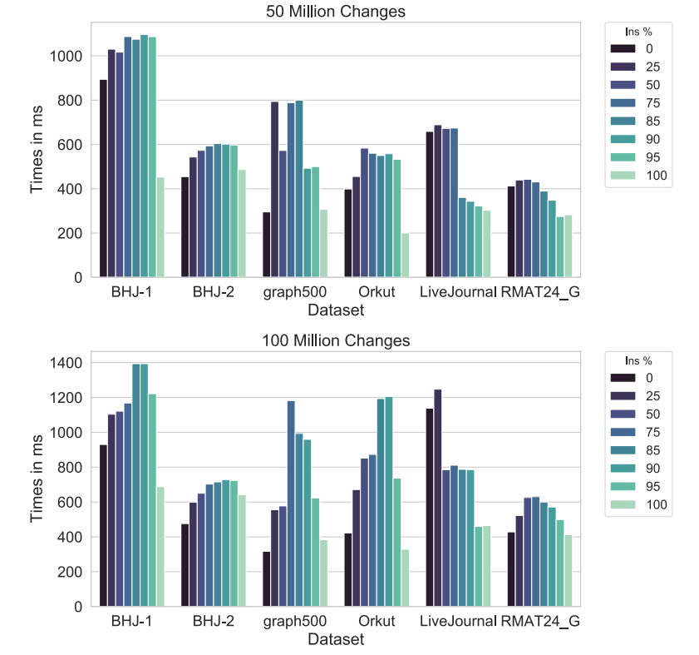



GPU IMPLEMENTATION RESULTS
50 million dataset
50 million dataset
Random network structure and changes
Graphs with Edge deletion takes more time

Slide 11
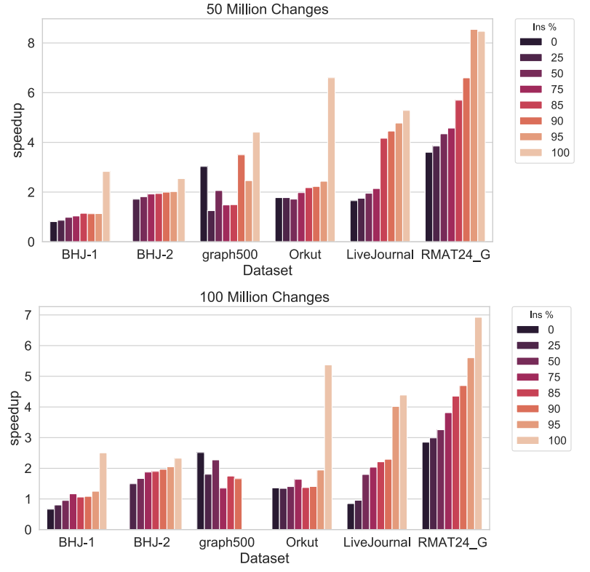


GPU PERFORMANCE COMPARISON
Gunrock (static)
8.5x for 50 million
Gunrock performes better for deletion cases
5.6x for 100 million

Slide 12
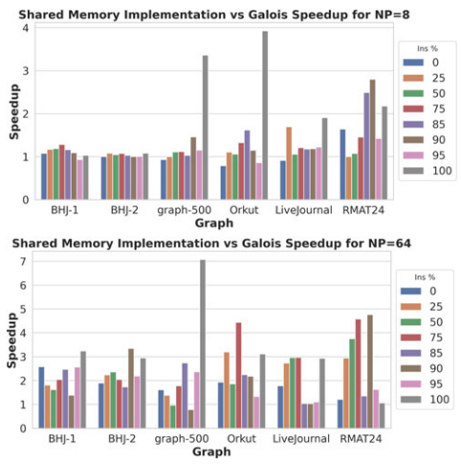


SHARED-MEMORY IMPLEMENTATION
RESULTS
Galois
etter when >85% nodes affected
Proposed method outperforms in most cases

Slide 13
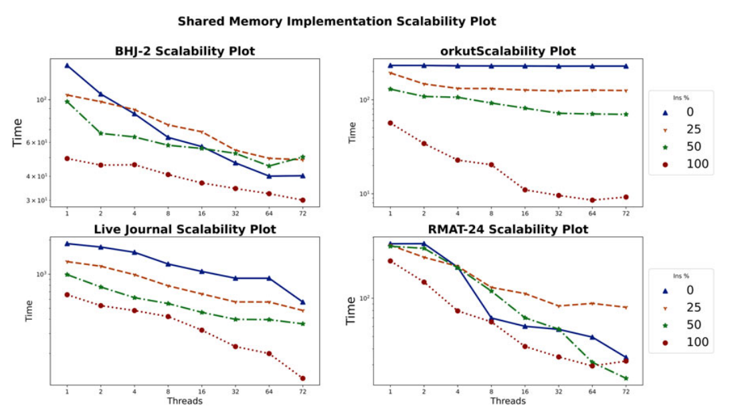
SHARED-MEMORY IMPLEMENTATION RESULTS

Slide 14
THANK YOU FOR
ATTENTION

